Slide 1

FOR THE BOLD
Joachim Batzke - 2016

Slide 2

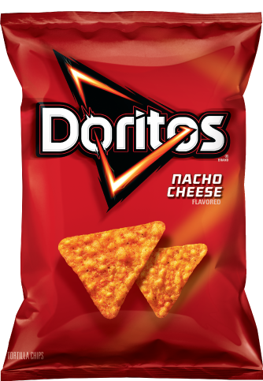
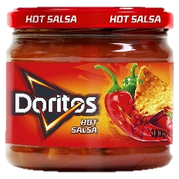
Problem 1: The Vicious Doritos Circle
I have Salsa left
I have Doritos left

Slide 3
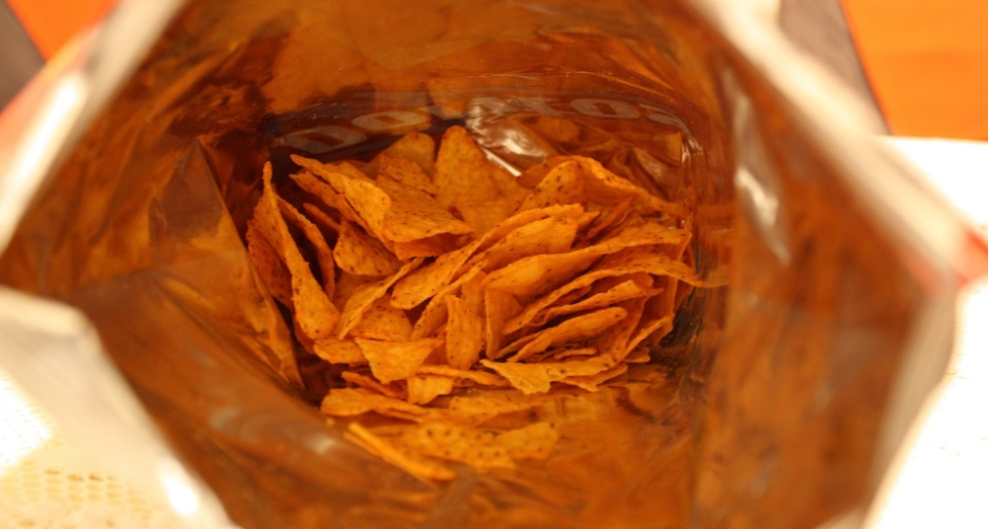
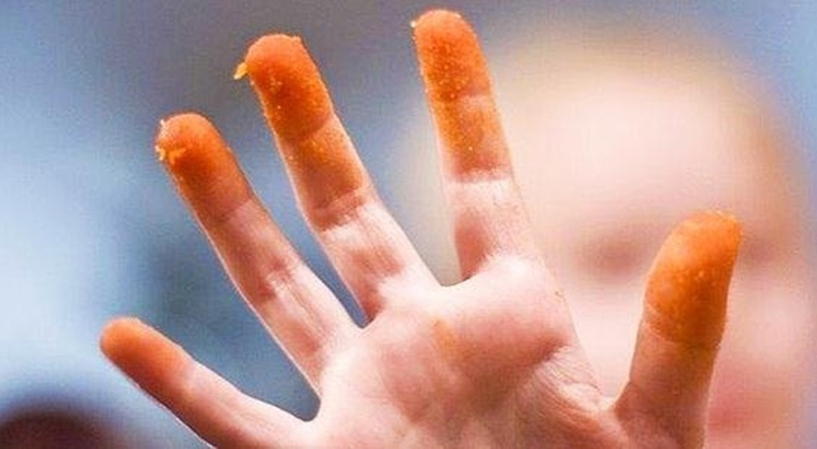
Problem 2
Only one hand at a time: Not social and not hygenic

Slide 4
Product Idea
A packaging that can be transformed into a bowl.
This makes eating chips more social.
By providing the right amount of salsa, the
“vicious doritos circle” can be broken.

Slide 5
Requirements

Slide 6
General Requirements
Purpose
Premium chips bag that allows for multiple consumers to grab chips at the same time while also providing the right amount of sauce and a reusable salsa bowl.
Functional specifications
The chips bag packaging easily transforms into a convenient chips bowl.
The chips bag packaging contains the perfect chip to dip ratio of 2:1
The chips bag packaging contains a reusable salsa bowl.
The chips bag packaging can be hold with one hand.
Other specifications:
The chips bag packaging and its contents will be distributed via the same channels as current Dorito products.
The price range of the whole package is between 2,50 € and 5 €.
The main materials that will be used are laminates, carton board and rigid plastics.

Slide 7
Legislation
HACCP
EC 1935/2004
EC No 2023/2006

Slide 8
Salsa Requirements
Requirements for the parts that conserve the salsa:
Non toxic materials that are approved for food packaging (GMP)
Oxigen Barrier
Humidity Barrier
Microbe barrier
Suitable for automated filling processes
Easy to open for the consumer

Slide 9
Chips Requirements
Requirements for the parts that conserve the chips:
Non toxic materials that are approved for food packaging (GMP)
Oxigen Barrier
Humidity Barrier
Microbe Barrier
Suitable for automated filling processes
Easy to open for the consumer
Protection against mechanical forces

Slide 10
Design
Brand
Usability

Slide 11

Usability
1. Take off the lid
2. Push down the sides
3. Put in chips and salsa
Enjoy and share! + Reuse the bowl

Slide 12
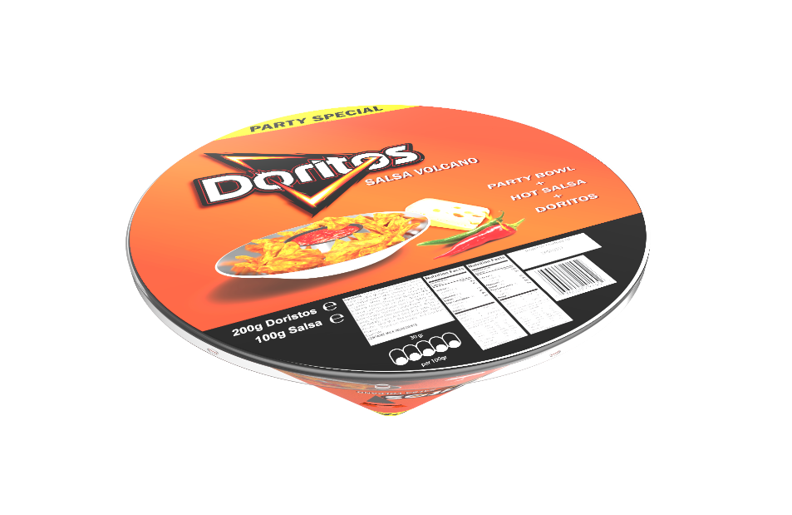
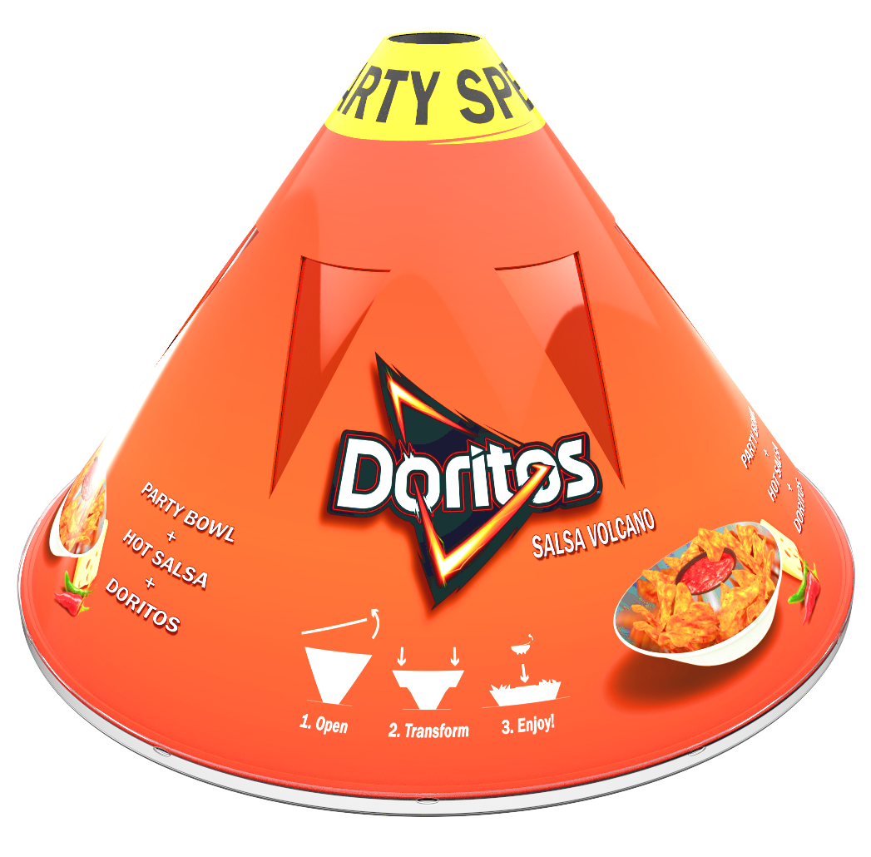
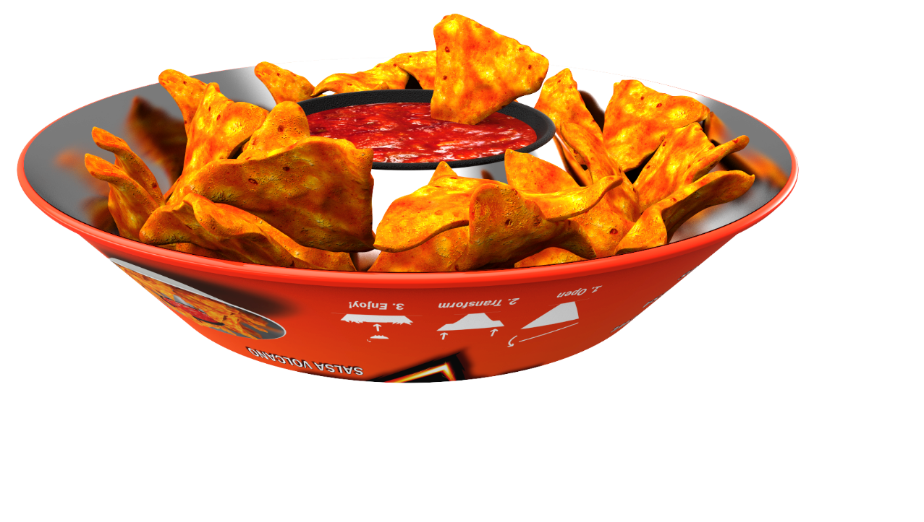
The Product
Triangles enable the transformation
Laminate prevents the chips from falling out

Slide 13
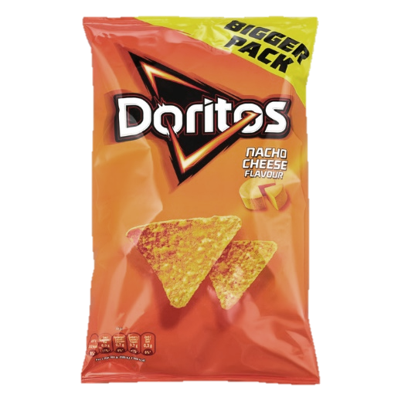
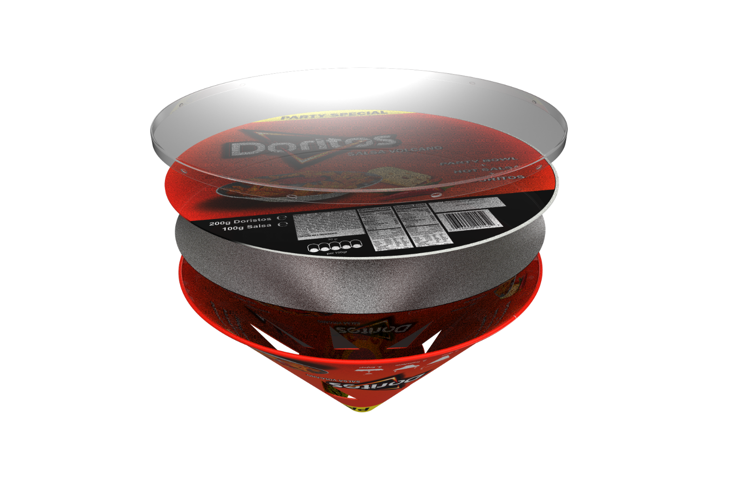
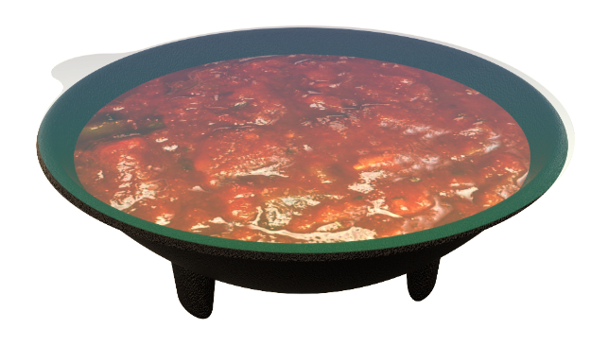
Exploded Overview
Lid for stability and closing
Printed Inlay
Laminate for the bowl
Transformable ‘’Volcano’’
200g Doritos + 100g Salsa

Slide 14
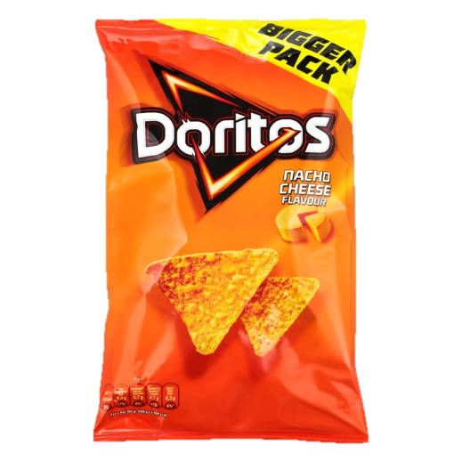
Doritos Branding
Dominant Logo
One or two images/ingredients
Slight gradient as a background color
Bulky Font
Use of drop shadows
Around 50% of empty space

Slide 15
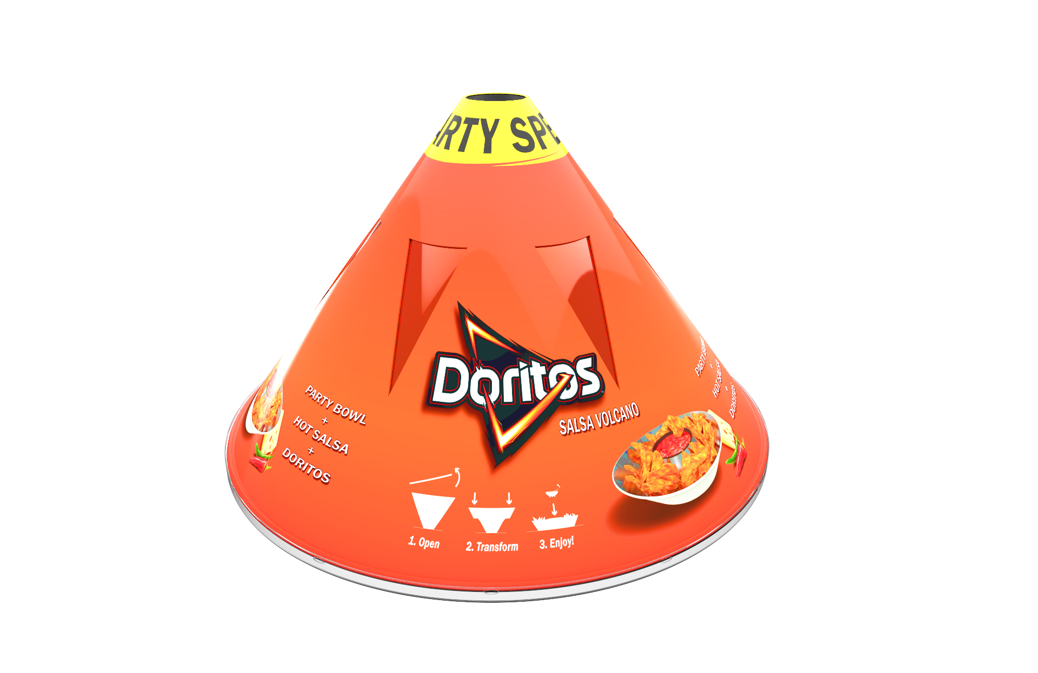
Doritos Branding
Dominant Logo
One or two images/ingredients
Slight gradient as a background color
Bulky Font
Use of drop shadows
Around 50% of empty space
+ Explanation

Slide 16
Materials
Production
Printing

Slide 17
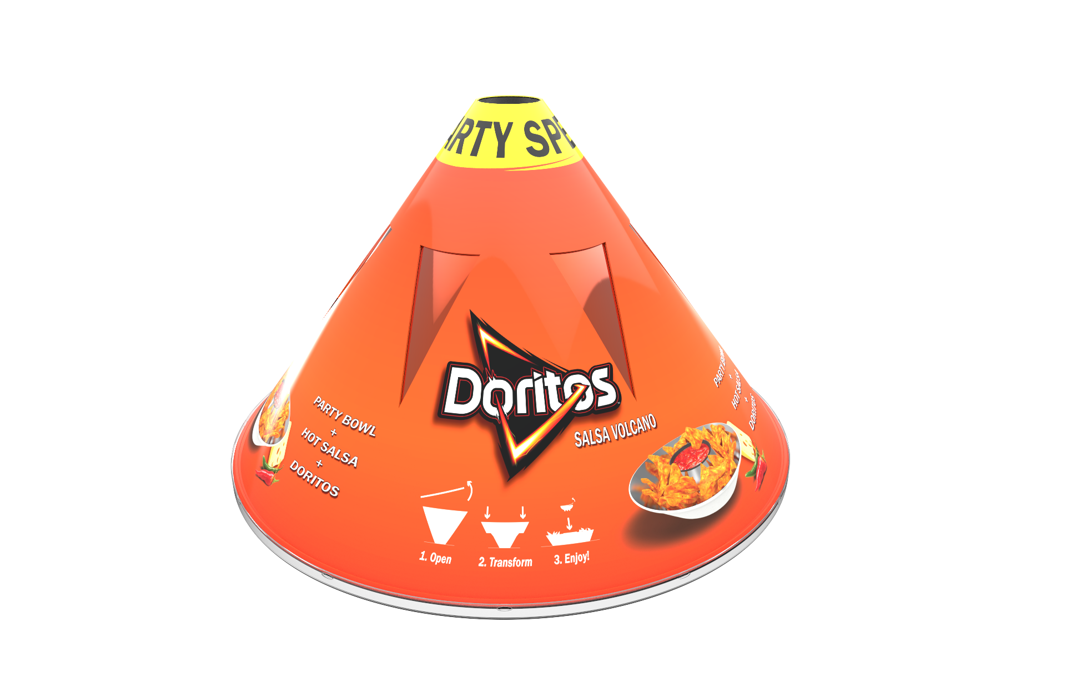
Volcano
Material
Board:
Coated folding boxboard with a cream reverse
(GC2 FBB) 0,45 mm (250g/m2)
Laminate:
Ink
Glue
metPET
PE
Notes:
Lamination: https://www.youtube.com/watch?v=KMJZOu7pJyc

Slide 18
Volcano Printing & Production
Printing
FBB: Sheet fed (520 x 720 mm) offset printing
Laminate: Flexo printing
Production
1. Die cutting of the triangles
2. Lamination of the laminate onto the FBB
3. Creasing & Die cutting
4. Manual folding, curling and glueing

Slide 19

Technical Drawing
Those creasing lines existe to facilitate curling
Material:
GC2 FBB 0,45 mm (250g/m2)

Slide 20
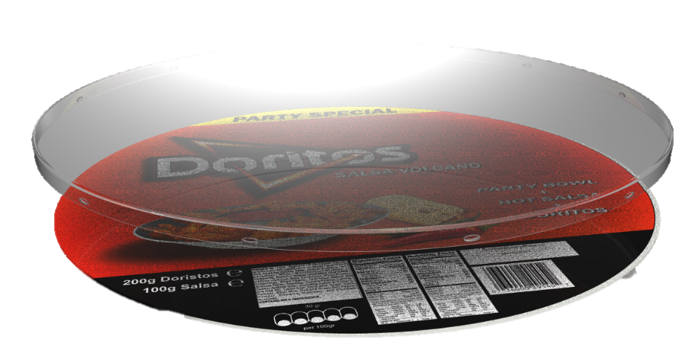
Lid & Inlay
Material
Lid: Transparent Polyethylene 0,2 mm (stability and humidity)
Inlay: Coated folding boxboard with a cream reverse (GC2 FBB) 0,45 mm (250g/m2)
Production technique:
Lid: Thin-gauge Thermoforming
Inlay: Sheet fed offset print
(fits on the volcano sheet)

Slide 21


Technical Drawing Lid
1 x 2,5 mm undercuts for fastening (12x)
Lid dimensions (in mm)
Inlay dimensions (in mm)

Slide 22

Salsa Bowl
Material
Bowl: Polypropylene
Seal: Heatflex for processed foods and easy peeling
Carrier: PET
Layer 2: OPA
Sealing: CPPpeel
Production technique
Bowl: Injection moulding
Foil: Cast extrusion and lamination
No printing or labelling
PET
OPA
CPPpeel

Slide 23


Technical Drawing Salsa Bowl & Seal
100ml Bowl dimensions (in mm)
Seal dimensions (in mm)

Slide 24
Chipsbag
Material
Laminate:
Ink
& Glue
Production technique
Cast extrusion & Lamination
Vertical form fill seal (MA)
Printing
Flexo (central impression)
OPP
metOPP

Slide 25

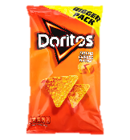
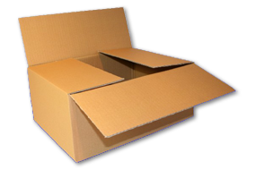
Secondary Package
Fefco 0201
Inner dimensions 595 x 395 x 470
Total weight of 16 products is less than 7 kg
Empty space is cushioned with chipsbags
Material
Single wall B Flute (3mm)
Kraftliner
Production technique
Slotting
Printing technique:
Unicolor flexo printing
Filling technique

Slide 26

Technical Drawing Secondary Package

Slide 27
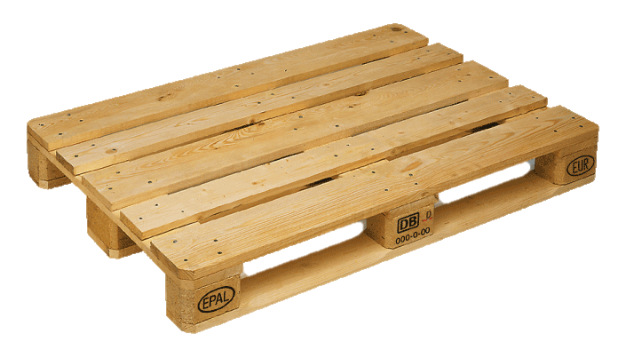
Tertiary package: Pallet & Wrap
Pallet:
1200 x 800 pallet
2m stacking height
16 Boxes on a pallet
= 256 products on one pallet
Stability:
Column stacking and wrap

Slide 28
Filling &
Cost Price

Slide 29
Filling Process
Lid
Doritos
Transwrap
(VFFS)
Manual Filling
Manual Closing
Chipsbag
Inlay
Laminate
Manual Closing
Empty
Volcano
Filled
Volcano
Closed Volcano
Sealing
Manual Filling
Automatic
Line Filling & Sealing
Secondary Package
Salsa
Salsa Bowl
Manual Filling
Stacking
Tertiary
Package
Bowl

Slide 30
Cost Price Estimations
Volcano & Inlay: GC2 FBB (1107 Eur/tonne) -> 100 gram per product = 0,117 €
Laminate: ~ 0,2 m2 is roughly 4ct * 3 (complex) = 0.12ct
Lid: 15 gram PE (1.50€/kg) * 3 (small series) = 0.067 ct
Chips Bag: Retail price 1.50€ * 0.5 = 0.75 €
Salsa bowl: 15 gram of PP (0.5 €/kg) * 3 (small series) = 0,022 €
Salsa + filling: Rough estimation 0.5 €
Secondary Package: (1,7m2 * 0,45€/m2) /16 = 0,047 ~ 5ct
The total cost will be between 1,62 € and 2 €
The product could be sold between 3,50 € and 4 € in retail.

Slide 31
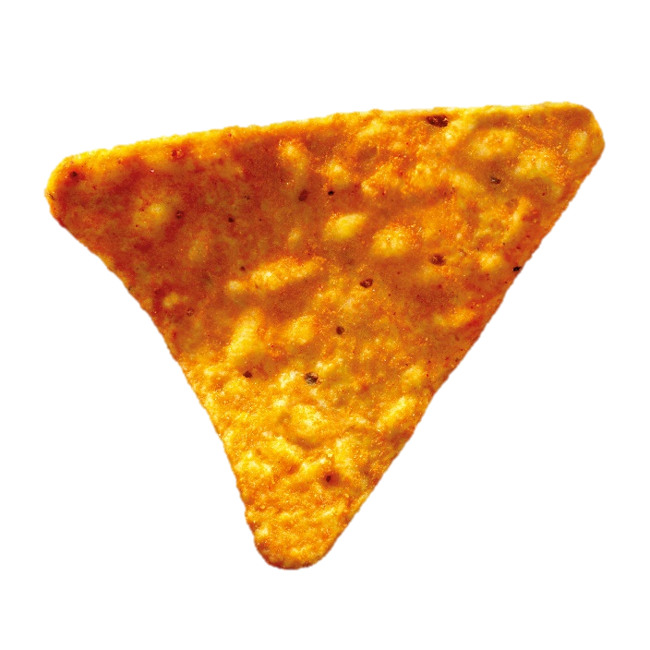
Thank you

